Slide 1
FRESHLENS
TEAM-4

Slide 2
AGENDA
TEAM MEMBERS
PROJECT OVERVIEW
MARKET ANALYSIS
PERSONAS
TECH STACK
TEAM LOGISTICS
RETROSPECTIVE

Slide 3
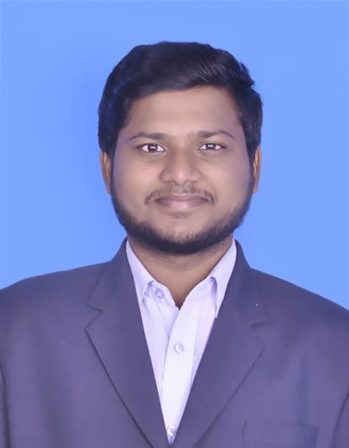
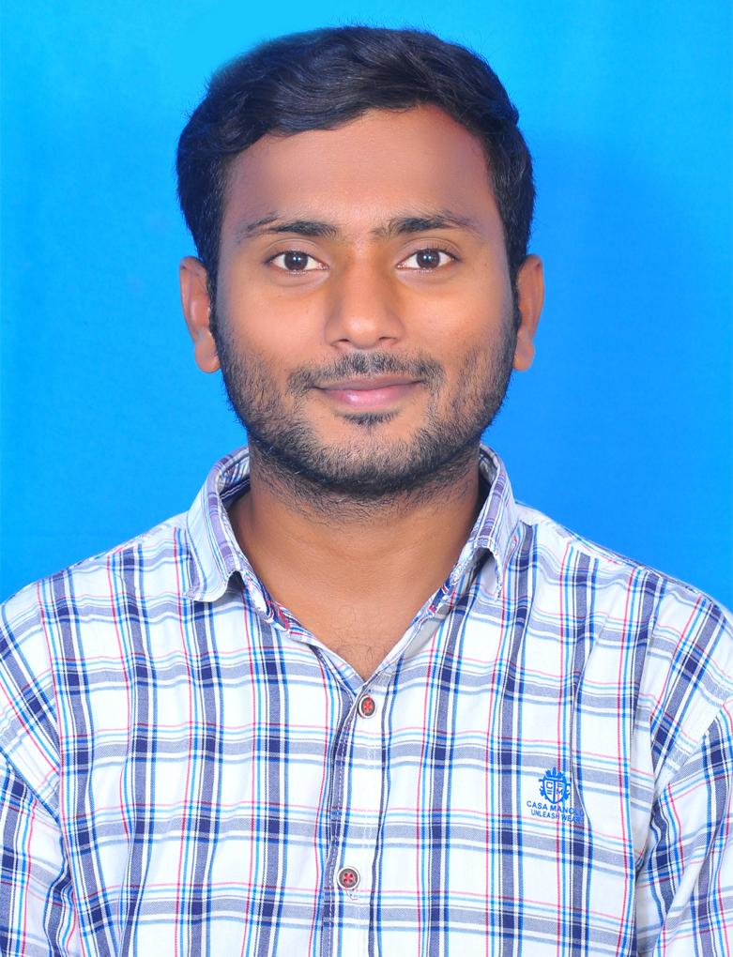
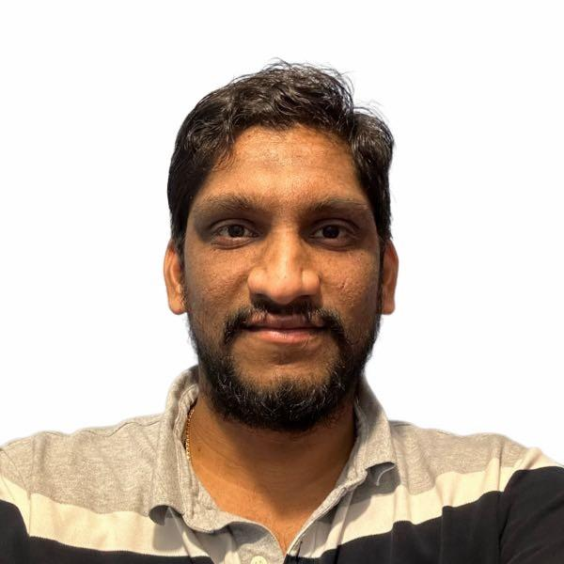
TEAM MEMBERS
Chandu Pentela Project Manager
Jaya Venkata Vara Sai Prakash Perumalla Backend Developer
Banoth Ashok Backend Developer

Slide 4
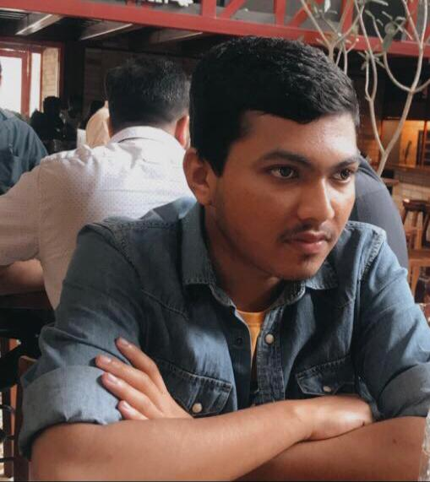
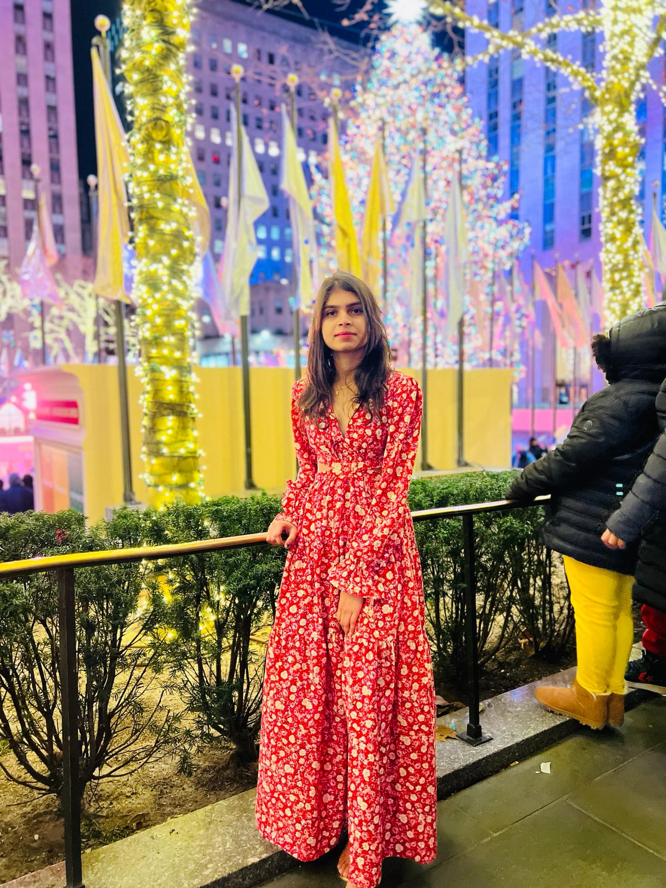
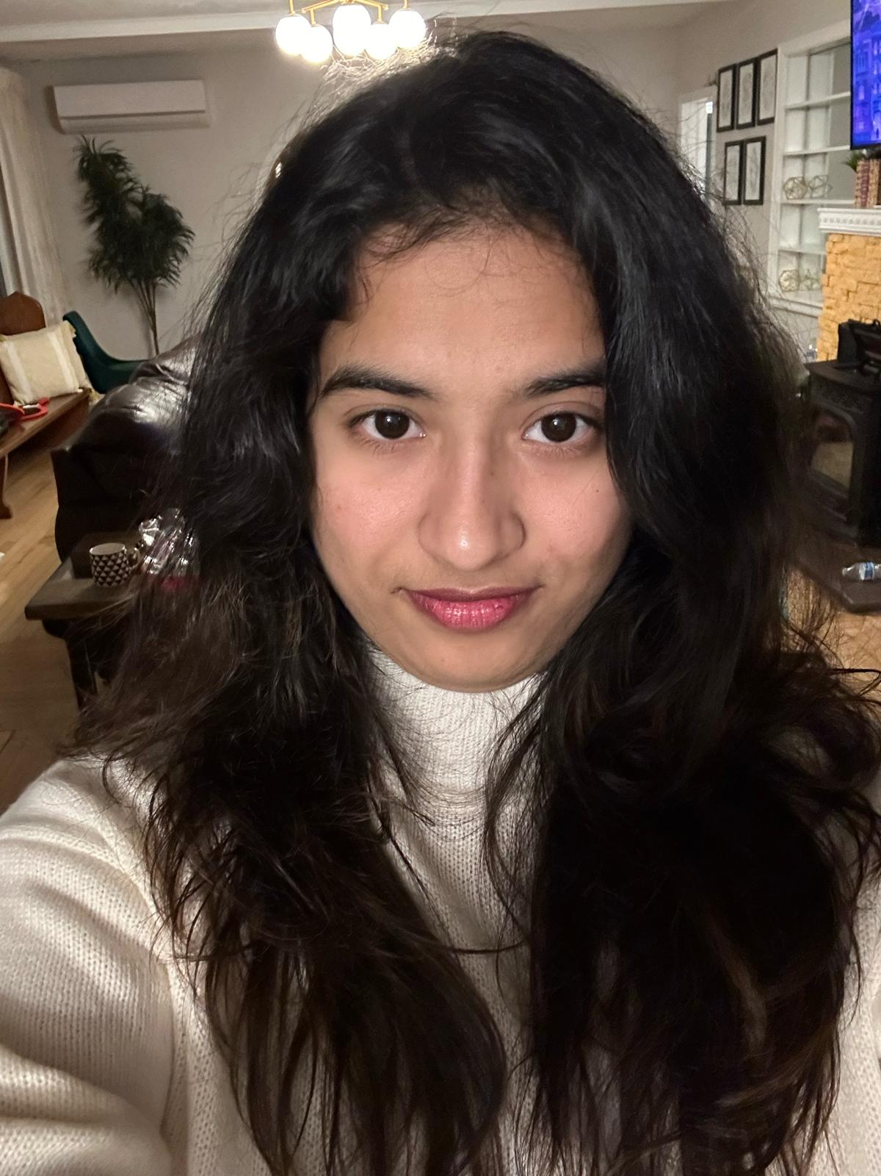
TEAM MEMBERS
Ashish Padma Machine Learning Engineer
Poojitha chinthala Machine Learning Engineer
Sushmitha Reddy Poddaturu Machine Learning Engineer

Slide 5
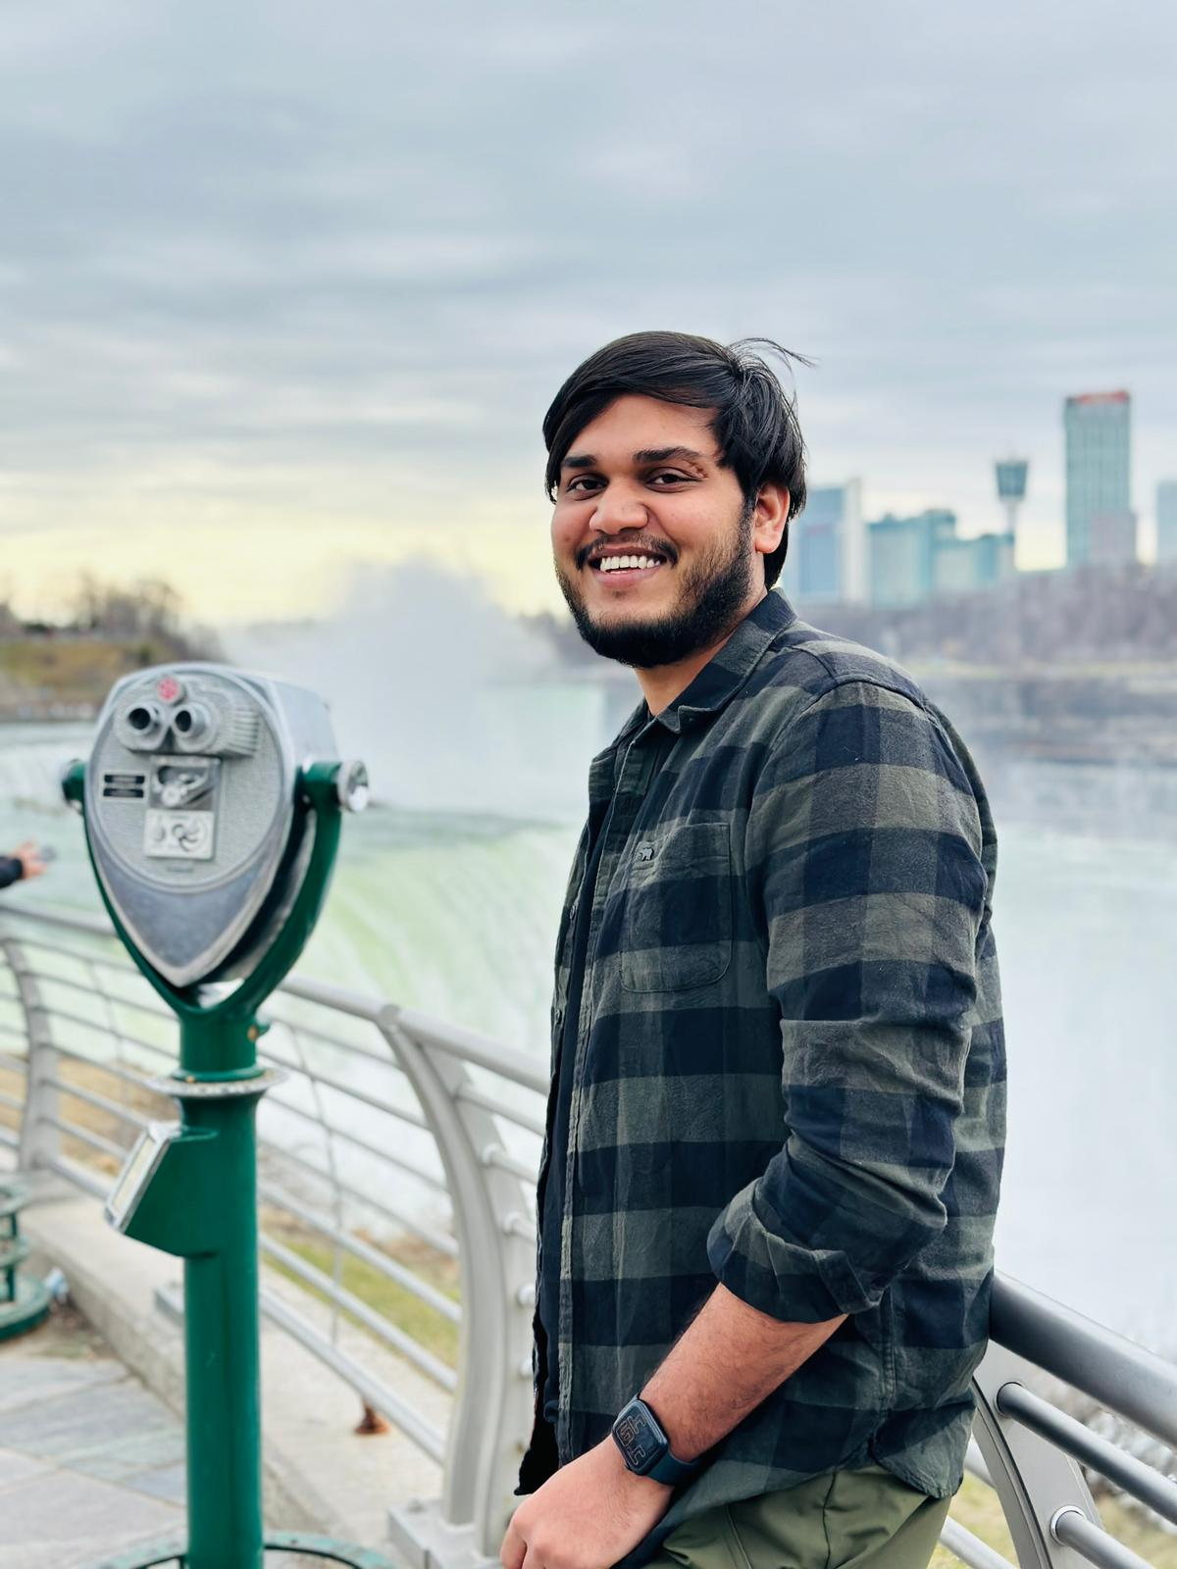
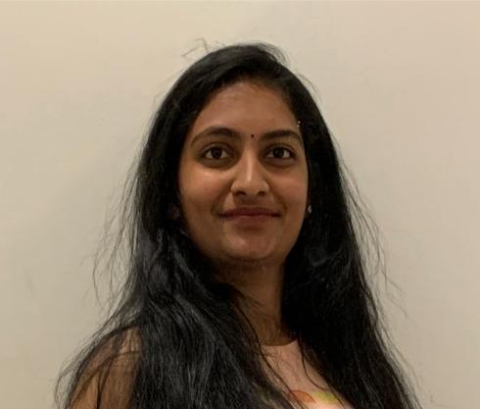
TEAM MEMBERS
Satish kumar reddy indla Developer
Aishwarya Kongari
Developer

Slide 6
PROBLEM STATEMENT
Many individuals want to maintain a healthy diet but they find it challenging to keep track of their diet and analyse it. The traditional way where keep logging food intake often time and it is prone to inaccuracies, which leads to poor diet choices and even demovitates the individual.
There needs to be a way for a more intuitive and efficient way to understand the nutritional values of fruits and easy to keep track of the intake. Which makes individuals to take healthy diet options.

Slide 7
PROJECT DESCRIPTION
FreshLens is a mobile application solution that uses advanced deep learning algorithms to identify fruits and vegetables from the capture of pictures by the user's device. The algorithm identifies and gives the calories and nutritional content of the scanned item and the information is saved over time it gives an in-depth analysis of the user’s dietary habits.

Slide 8
MARKET ANALYSIS
The diet and nutrition apps market is growing rapidly by increasing awareness of health and wellness and even increasing in use of AI. In the US, the market is expected to reach $15 billion by 2029 with a CAGR of 21.4% from 2022 to 2029. Major players are entering this market and making the space competitive increasing in chances of opportunities and innovation in this space.

Slide 9
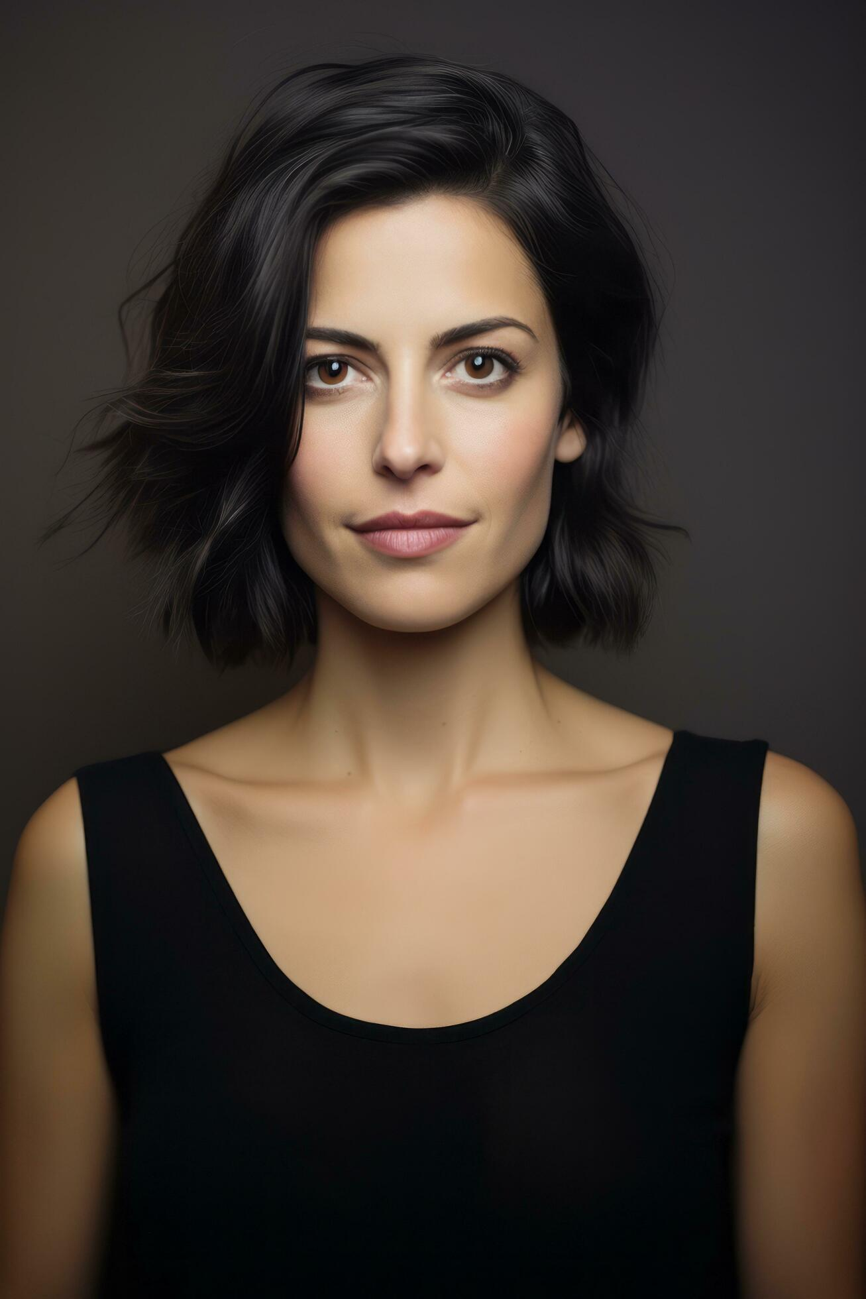
PERSONAS
Name: Emily
Age: 30
Occupation: Marketing Analyst
Interests: Yoga, cooking, and reading health blogs
Goals: Maintain a balanced diet
Challenges: Struggles to find accurate nutritional info for fresh produce
How Your App Helps: FreshLens offers instant nutritional content, supporting her balanced diet and culinary exploration.

Slide 10
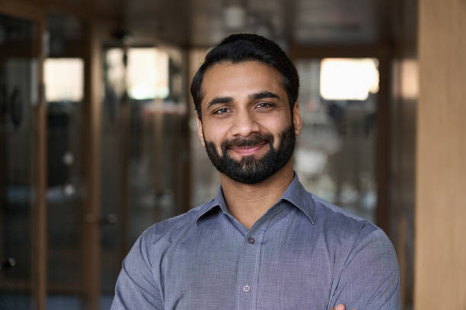
PERSONAS
Name: Alex
Age: 35
Occupation: Software Engineer
Interests: Tech gadgets, hiking, fast cooking
Goals: Eat healthily despite a busy schedule
Challenges: Has limited time for meal prep and nutrition tracking
How Your App Helps: FreshLens easily fits in busy lifestyle, it's designed for healthy eating with quick scan

Slide 11
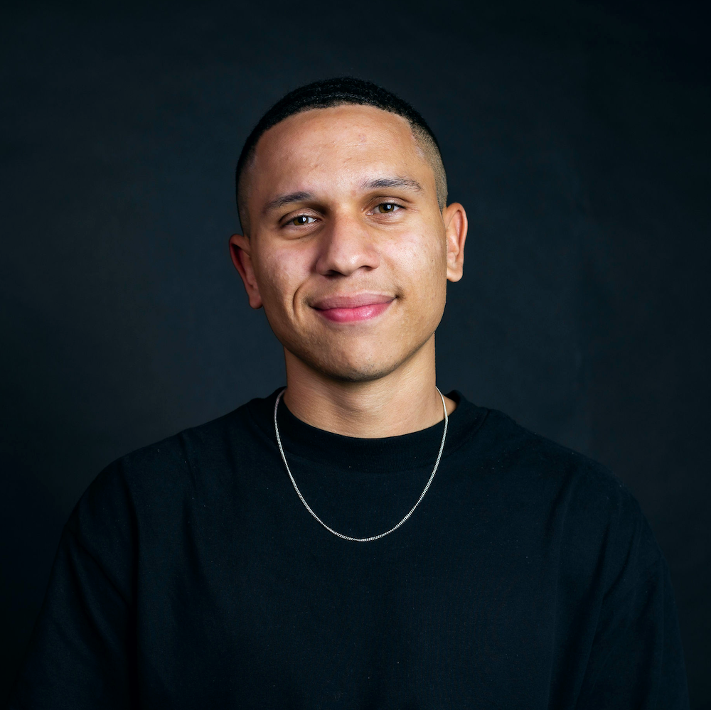
PERSONAS
Name: Jordon
Age: 26
Occupation: Personal Trainer
Interests: Gym workouts, sports nutrition, bodybuilding
Goals: Optimize diet for muscle gain and performance
Challenges: Needs precise macro and micro intake from natural foods
How Your App Helps: FreshLens helps in tracking nutritional values, enhancing his meal planning.

Slide 12








TECH STACK

Slide 13
SPRINT SCHEDULE
Point | Activity | Assigned to | Duration
1 | Project Introduction | Entire Team | 2 days
2 | Role Definition | Entire Team | 2 days
3 | Discussion on Project Scope | Entire Team | 1 day
4 | Initial Tech Stack | Developers | 2 days
5 | Project Draft Plan | Entire Team | 3 days

Slide 14
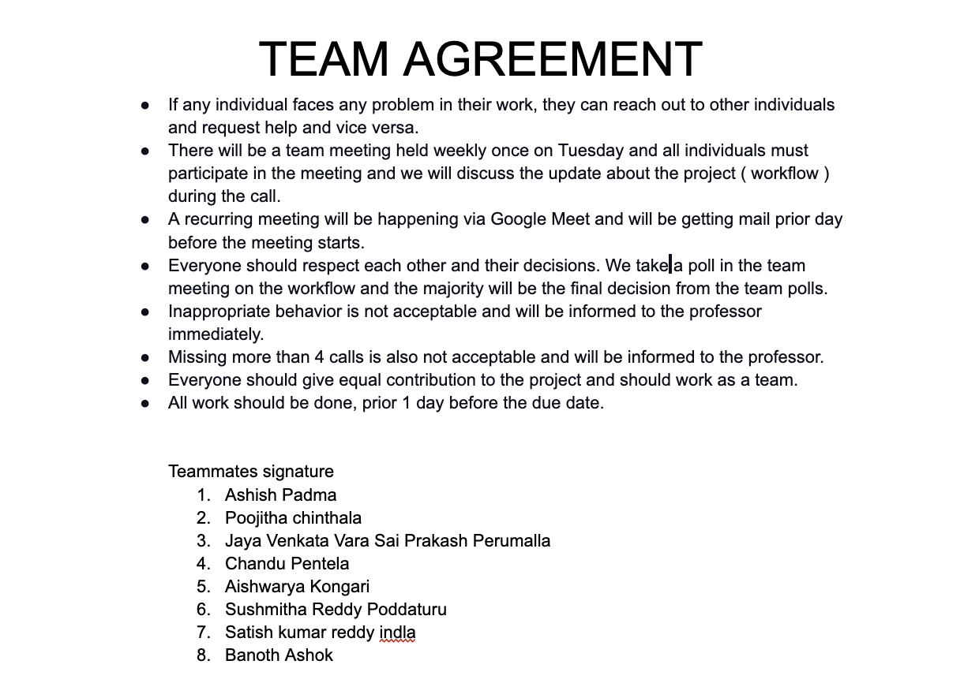
TEAM WORKING AGREEMENT

Slide 15
RETROSPECTIVE
WHAT WENT WELL
Quick decision making
Attending meetings
WHAT WE CAN IMPROVE
Improve the communication among team.
ACTION ITEMS
Not going overboard
Recurring meetings.

Slide 16
Wikipage link
https://github.com/htmw/2024S-Sierra/wiki

Slide 17
THANK YOU

